Slide 1

PostgreSQL ADVANCE CONCEPTS

Slide 2

Object-Oriented SQL for Data Complexity
PostgreSQL is an advanced high-level query language that includes data import and export features.
For Big Data applications and even machine learning apps, the CSV import and export tools are very popular PostgreSQL tools.
PostgreSQL fills important gaps for ordinary SQL, especially for web apps and mobile apps that deploy Java code and need fast query capability from a highly scalable database.

Slide 3


Let’s see some of the advance queries

Slide 4
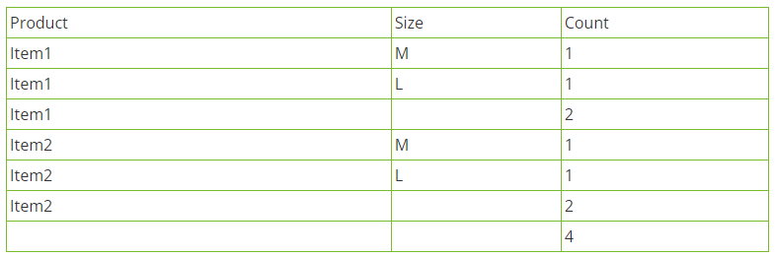
ROLLUP QUERY
ROLLUP is one of the most important PostgreSQL advanced queries. It is an alternative that is possible in Postgres that enables users to generate hierarchical rollups beginning with the primary accumulation and accompanied by the others in the hierarchical form. This regime is designated by the order in which the entries develop in the GROUP BY clause.
Example: Output:
SELECT Product, Size, count(*)
FRO<strong>M</strong> orders
GROUP BY ROLLUP(Product, Size)
The output is displaying the order reports for a particular size within a particular item, a product subtotal at the item level, and the elevated total with all items combined.

Slide 5
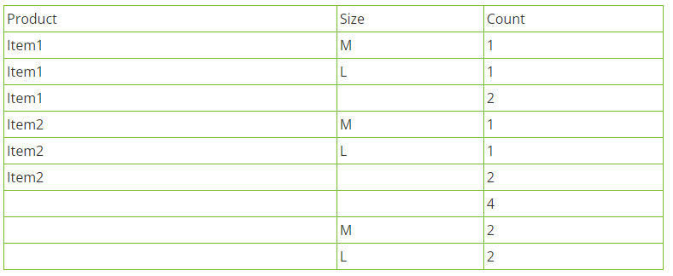
CUBE QUERY
CUBE is the best feature of the PostgreSQL tutorial. It is another requirement possible in Postgres that enables users to get all sequences. Fundamentally, CUBE will give a consolidated summary of collections and the hierarchical rollup.
Example: Output:
SELECT Product_Name, Size, Count(*)
FRO<strong>M</strong> sales
GROUP BY CUBE(Product_Name, Size)

Slide 6
INDEX QUERY
An index is one of the best and most important portions of PostgreSQL documentation. Indexes are exceptional lookup records that the database can utilize to expedite up data retrieval. In other words, an index is a mark of data in a table. An index in a database is quite alike to an index of a book.
Example:
The following is an example which is displaying an index on the Employee table for the Employee number (Eno) column.
QUERY:
CREATE INDEX eno_index ON E<strong>M</strong>PLOYEE (Eno);

Slide 7
HAVING CLAUSE QUERY
If you want to learn PostgreSQL then the HAVING clause is one of the most significant PostgreSQL advanced features. The HAVING clause is utilized to define which particular group(s) are to be presented.
Example:
If you want to present the record of the average salary for all departments having more than 5 employees from the EMP table, the following SQL can be applied:
QUERY:
SELECT deptno, AVG(salary)
FROM emp
GROUP BY deptno
HAVING COUNT(*)>5;

Slide 8
MISSING VALUES IN A SEQUENCE
Usually, programmers utilize sequences in the tables as primary keys. But several values probably miss or get deleted which really can be worked on again. But for big tables, it is challenging to discover these missing values. So, in such circumstances, programmers can apply the following query to obtain the initial missing values.
Example:
SELECT empno + 1
FRO<strong>M</strong> emp a
WHERE NOT EXISTS
(
SELECT NULL
FRO<strong>M</strong> emp b
WHERE a.empno = b.empno + 1
)
ORDER BY empno

Slide 9
RANK() FUNCTION
The rank function is the most crucial part of the PostgreSQL tutorial. This function comes under the Windows function. It allows ranking within an organized partition. If the contents of the two rows are the equivalent, the RANK() function allocates the identical rank, with the next ranking(s) hopped.
Example:
SELECT
product,
grp_name,
price,
RANK () OVER (
PARTITION BY grp_name
ORDER BY
price
)
FRO<strong>M</strong>
substances
INNER JOIN products USING (productid);

Slide 10
EXPLAIN STATEMENT
The EXPLAIN statement in PostgreSQL displays the execution. This is the plan which the planner creates for a written SQL statement. For instance, the EXPLAIN displays how objects like tables included in an SQL statement will be parsed and examined by index scan or consecutive scan, etc., and if various tables are used, what sort of join algorithm is applied. The most valuable and practical data that the EXPLAIN statement gives are the start cost and the total cost to deliver the entire result set. In this, the ANALYZE statement actually completes the SQL statement and drops the resulting information. The following is an example:
Example:
EXPLAIN SELECT * FROM emp1;
QUERY PLAN
-------------------------------------------------------------
Seq Scan on emp1 (cost=0.00..451.00 rows=15000 width=364)

Slide 11
CREATE ROLE
PostgreSQL applies roles to describe user accounts. It doesn’t apply to the user like other relational database management systems. For example, in PostgreSQL, the normal user is identified using roles. The create a role statement is used to create new users. Normally, roles that can log in are described as login roles. They are similar to users and when roles include distinct roles, they are called group roles. The following statement displays the example of the CREATE ROLE statement. This statement is creating a new role called jeff:
Example:
CREATE ROLE jeff
LOGIN
PASSWORD 'myPass1’;
Now, to see all roles in the PostgreSQL database server, you have to use the pg_roles system file as follows. The only important thing to remember here is that roles that begin with pg_* are always system roles.
SELECT rolname FROM pg_roles;

Slide 12

THANK YOU!

